Slide 1
Image Segmentation
Last updated: 19-3-2024
[SR] Szeliski R., Computer Vision - Algorithms and Applications, Springer, 2011. (Ch. 4, 5)
[GR1] Gonzalez R. C., Woods R. E., Eddins S. L., Digital Image Processing Using Matlab, Pearson Education, 2nd edition, 2009. (Ch. 10)
[GR2] Gonzalez R. C., Woods R. E., Eddins S. L., Digital Image Processing, Pearson Education, 3rd edition, 2007. (Ch. 10)
Slides adopted from: Dr. Zulfiqar Habib, Professor

Slide 2
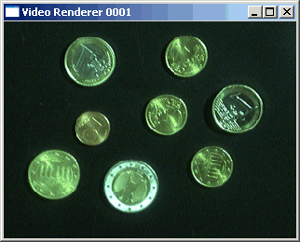

The Segmentation Problem
Segmentation attempts to partition the pixels of an image into groups that strongly correlate with the objects in an image.
Typically, among the first few steps in any automated computer vision application.

Slide 3
Image Segmentation
Model Generation
(ML / DL)
Models
Image acquisition
Preprocessing
Segmentation
Feature extraction
Classification
Problem domain
Result
The role of Image segmentation
in an image classification pipeline
Notes:
Regression and classification are categorized under the same umbrella of supervised machine learning. ... The main difference between them is that the output variable in regression is numerical (or continuous) while that for classification is categorical (or discrete)

Slide 4
Contents
Thresholding
The segmentation problem
Finding points, lines and edges

Slide 5
Thresholding
Thresholding enjoys a central position in image segmentation.
First we will continue to look at the problem of segmentation, this time though in terms of thresholding.
In particular we will look at:
What is thresholding?
Simple thresholding
Adaptive thresholding

Slide 6
Simple Thresholding
Thresholding is usually the first step in any segmentation approach
Single value thresholding can be given mathematically as follows:

Slide 7
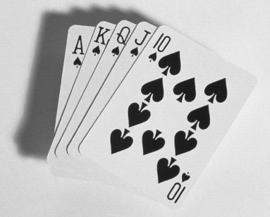
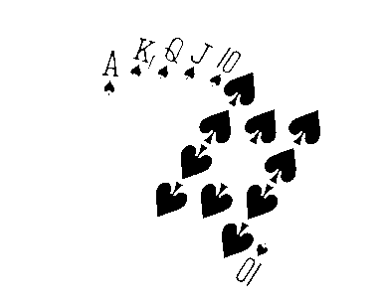
Thresholding Example
Imagine a poker playing robot that needs to visually interpret the cards in its hand
Original Image
Thresholded Image

Slide 8
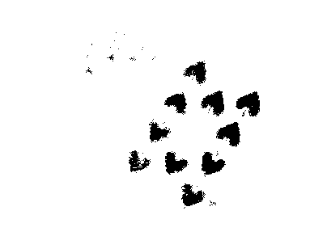
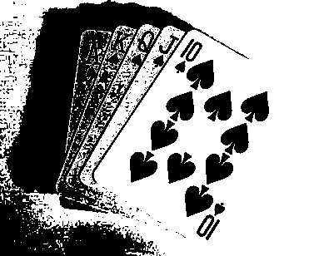
But Be Careful
If you get the threshold wrong the results can be disastrous
Threshold Too Low
Threshold Too High

Slide 9
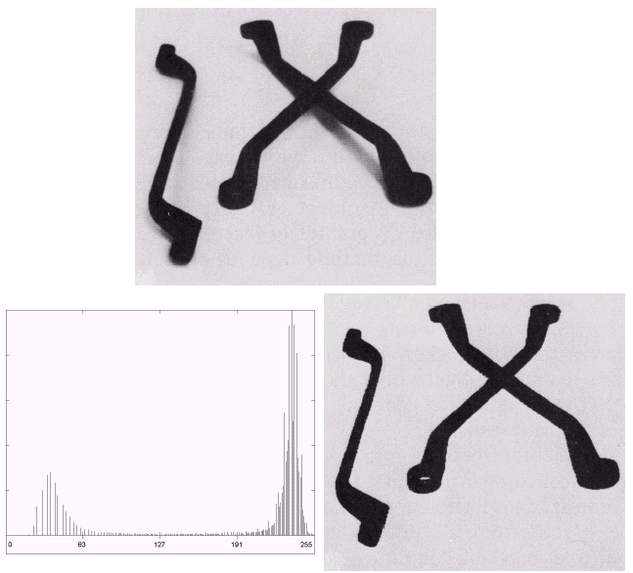
Basic Global Thresholding
Based on the histogram of an image
Partition the image histogram using a single global threshold
The success of this technique very strongly depends on how well the histogram can be partitioned

Slide 10
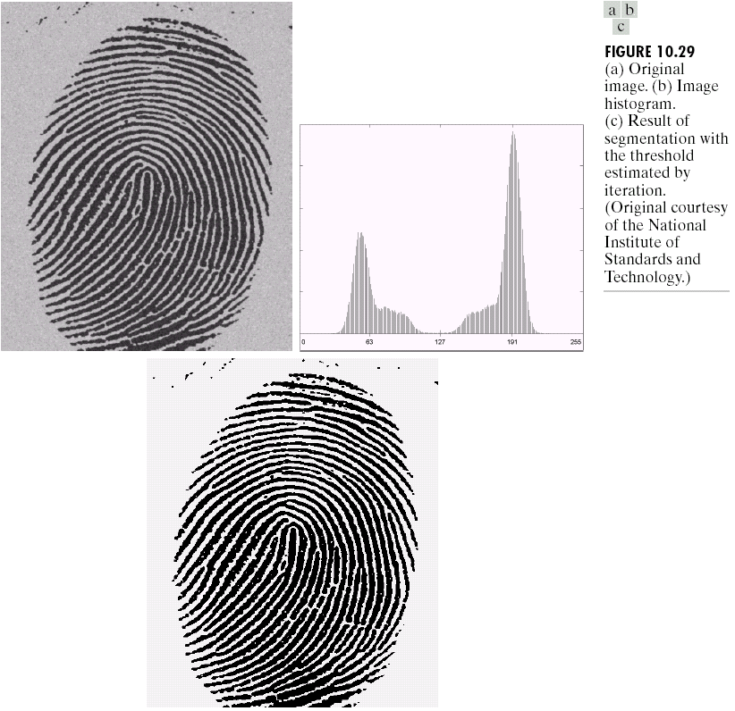

Basic Global Thresholding
Images taken from Gonzalez & Woods, Digital Image Processing (2002)

Slide 11
Basic Global Thresholding Algorithm
The basic global threshold, T, is calculated
as follows:
Select an initial estimate for T (typically the average grey level in the image)
Segment the image using T to produce two groups of pixels:
G₁ consisting of pixels with grey levels >T and
G₂ consisting pixels with grey levels ≤ T
Compute the average grey levels of pixels in G₁ to give μ₁ and G₂ to give μ₂

Slide 12
Basic Global Thresholding Algorithm
Compute a new threshold value:
Repeat steps 2 – 4 until the difference in T in successive iterations is less than a predefined parameter T₀
This algorithm works very well for finding thresholds when the histogram is suitable

Slide 13
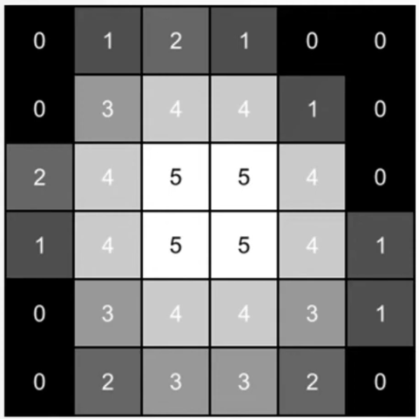
TODO Task
1. Apply the above global thresholding algorithm to the following image:
2. Implement the global thresholding method in Python from scratch (without using any built-in libraries).

Slide 14
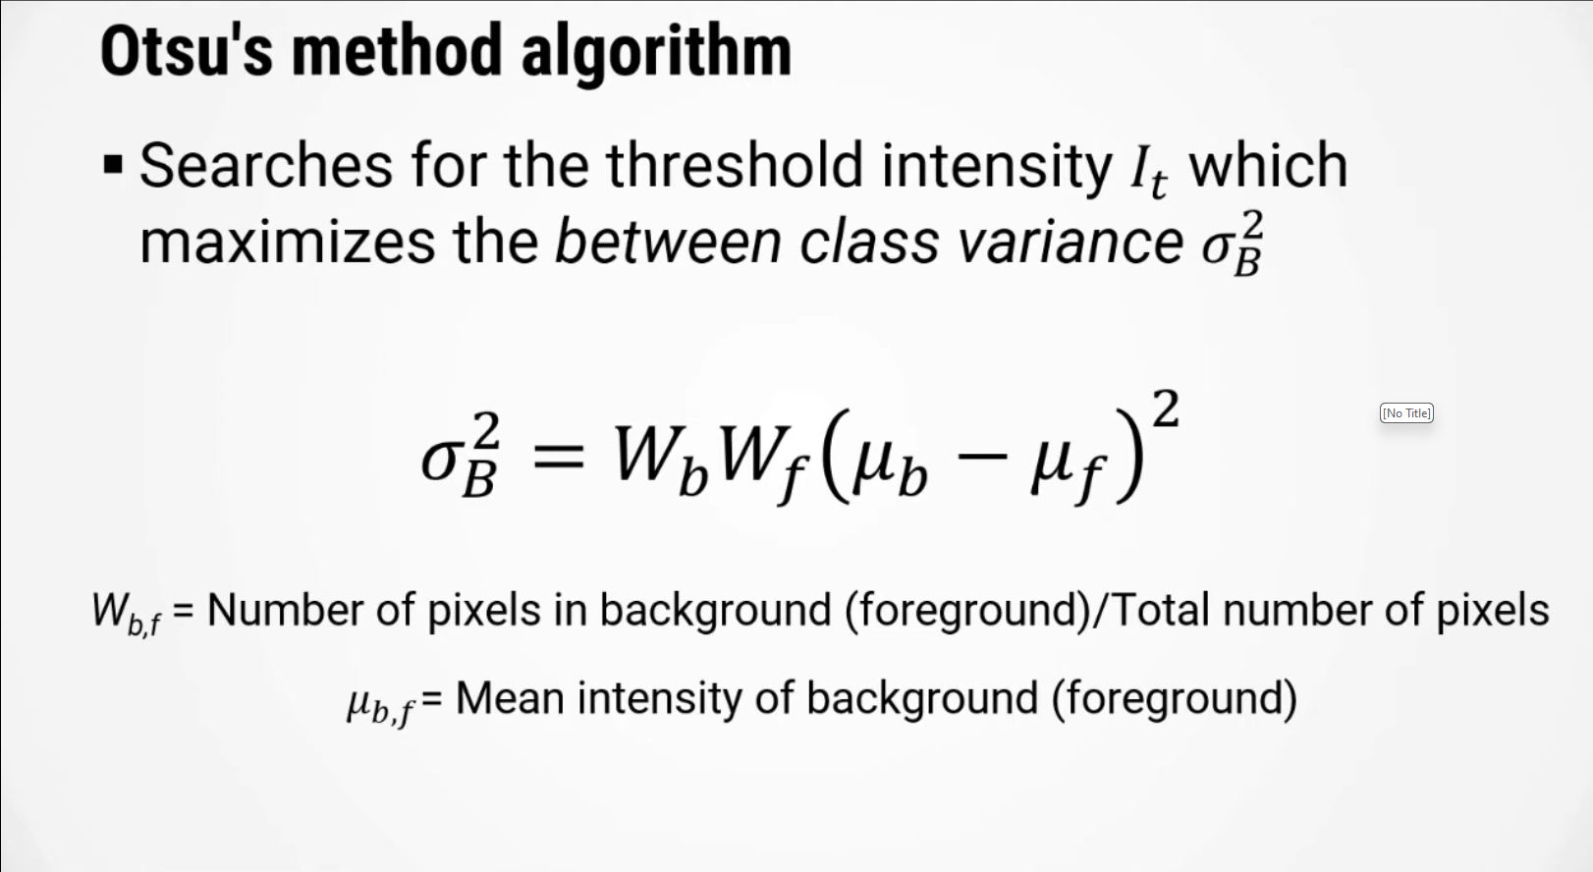

Slide 15
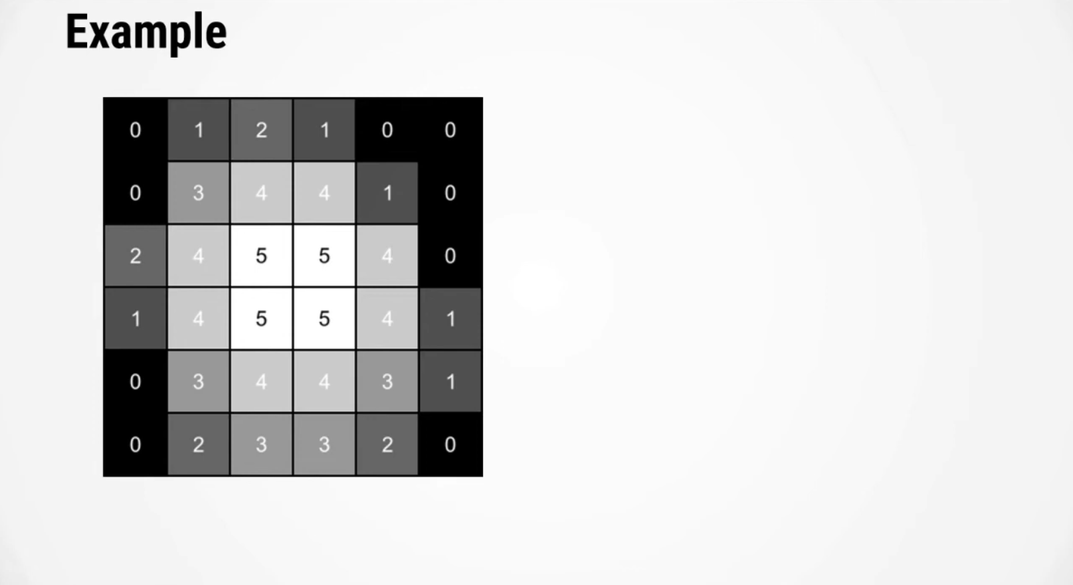

Slide 16
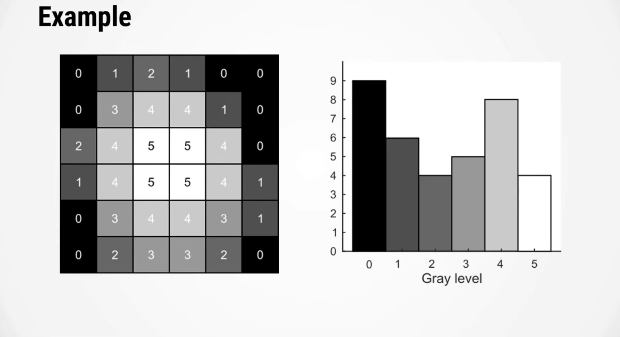
9
8
6
5
4
4
Image Histogram
(Frequency of each gray level in the image)

Slide 17
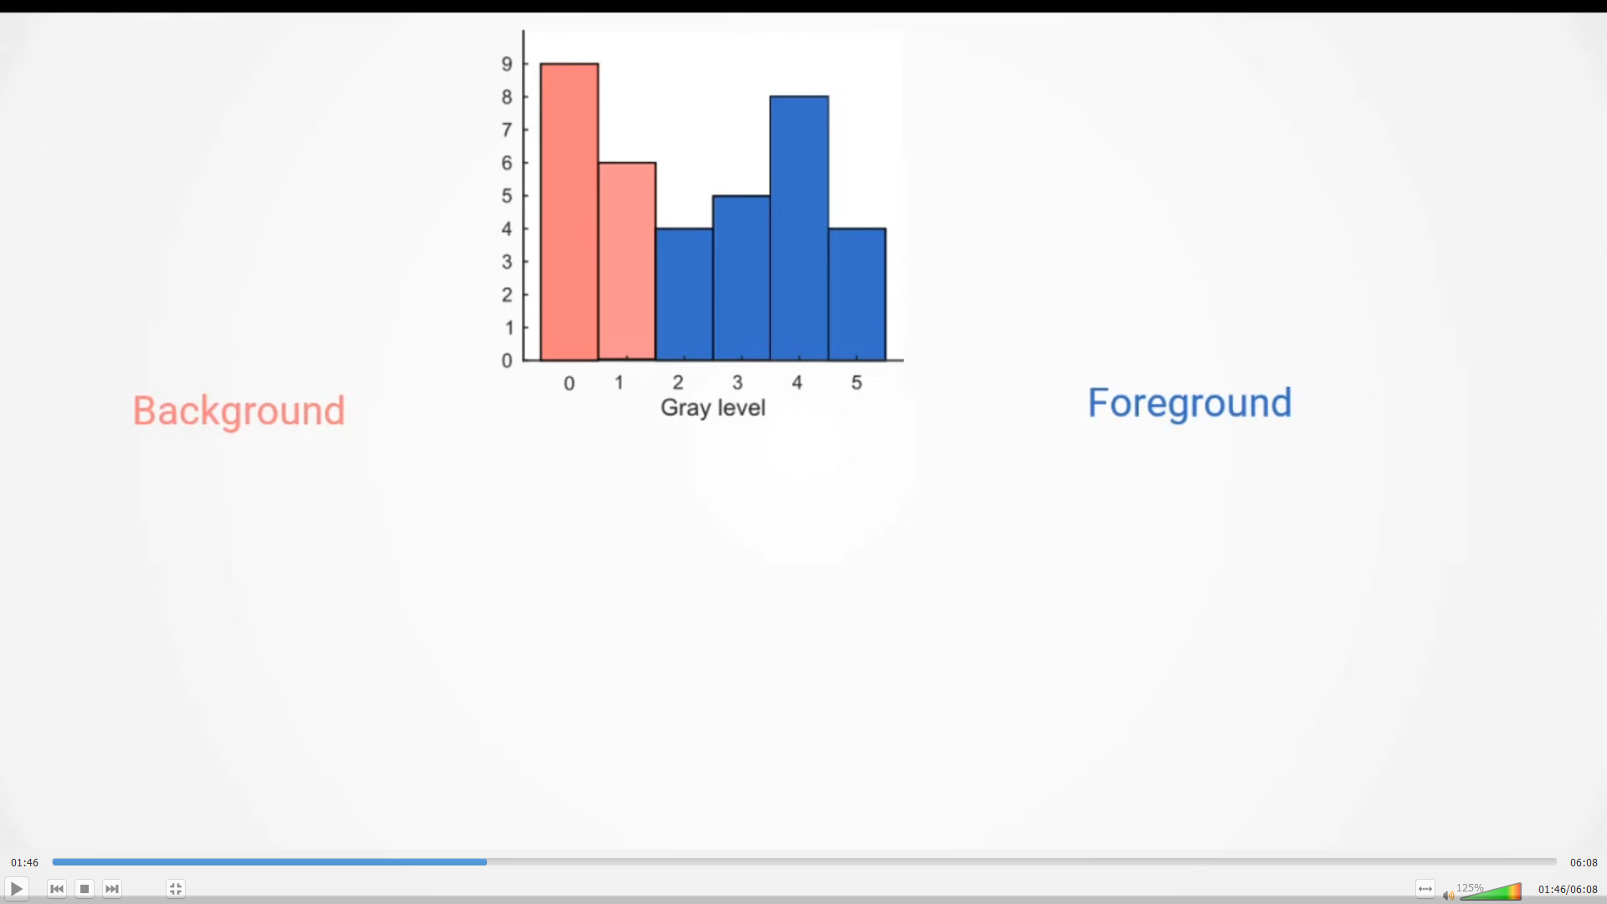

Slide 18
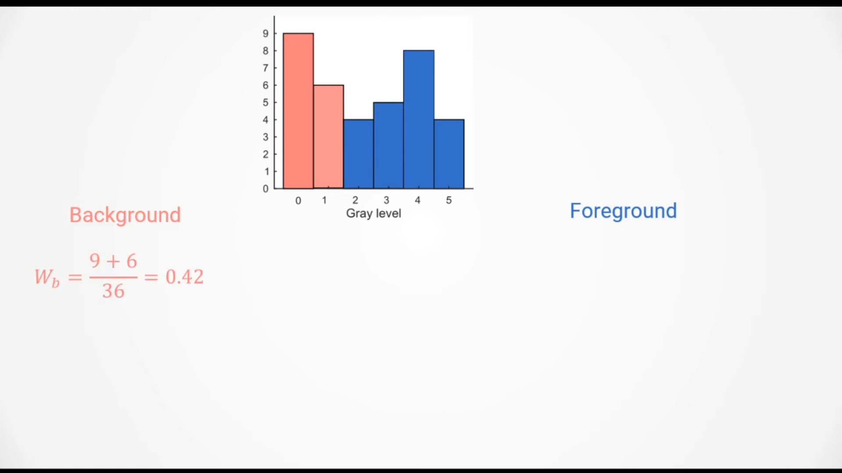

Slide 19
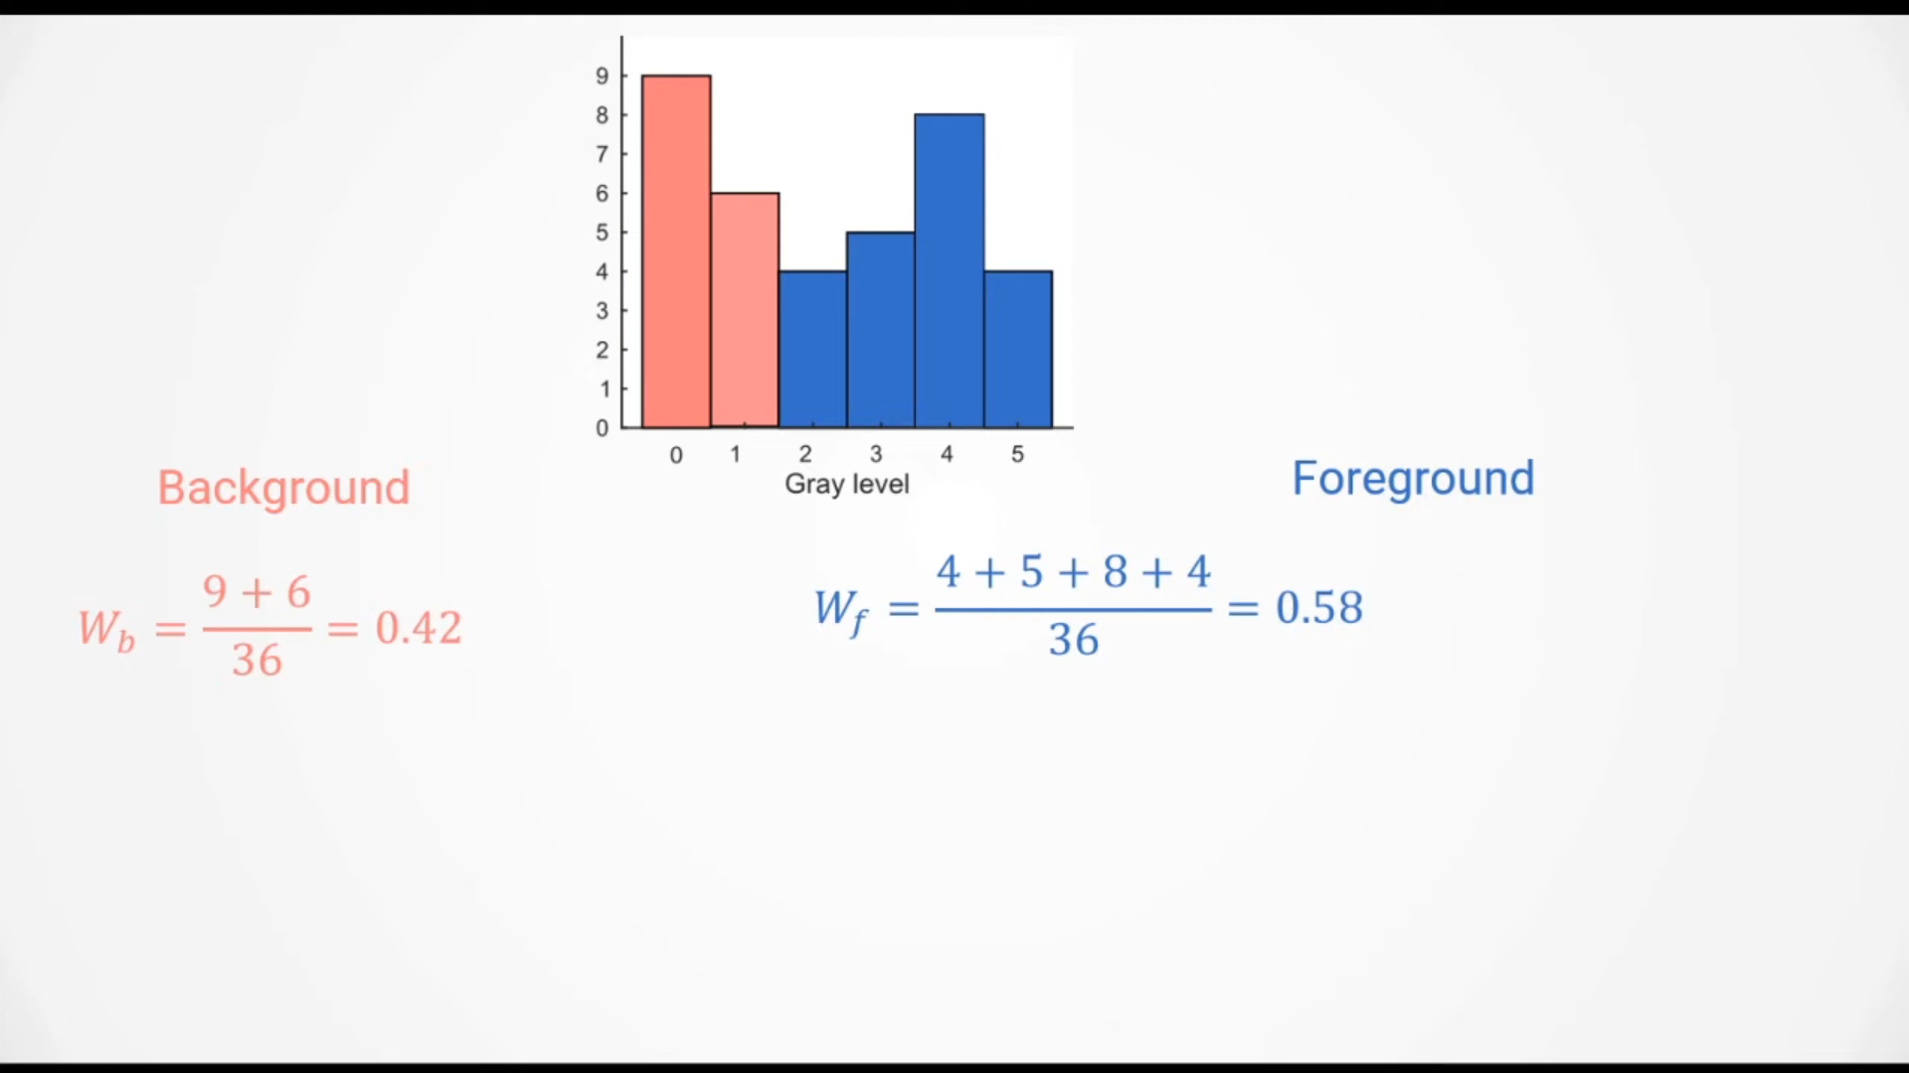

Slide 20
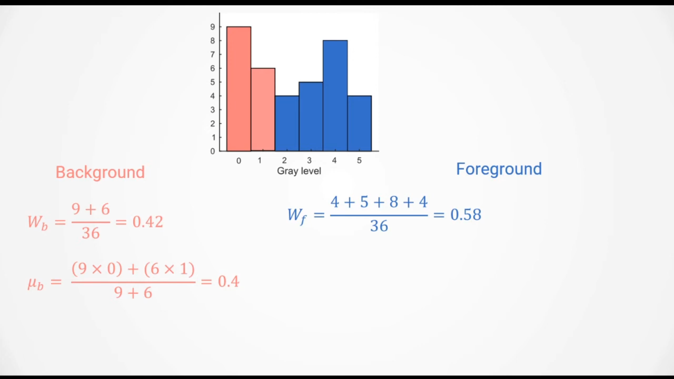

Slide 21
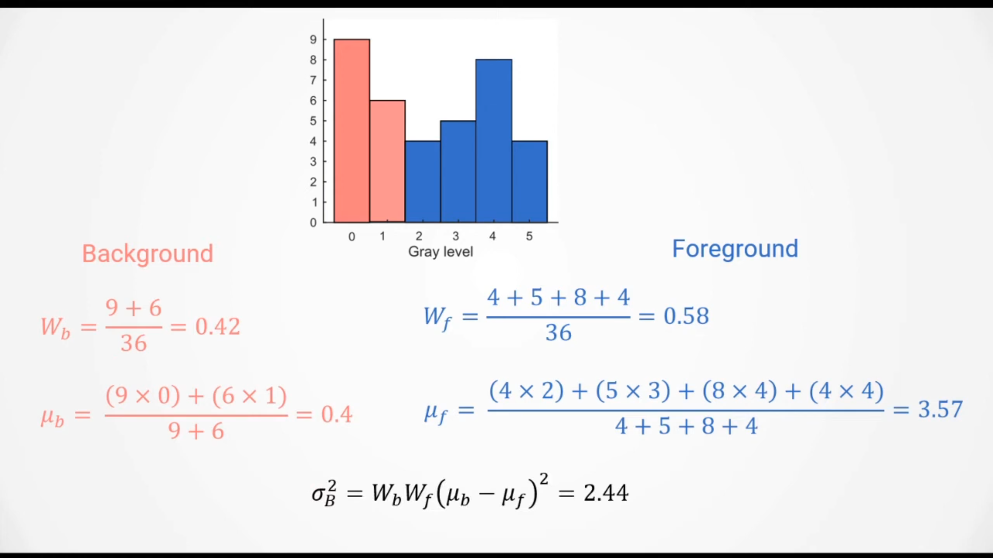

Slide 22
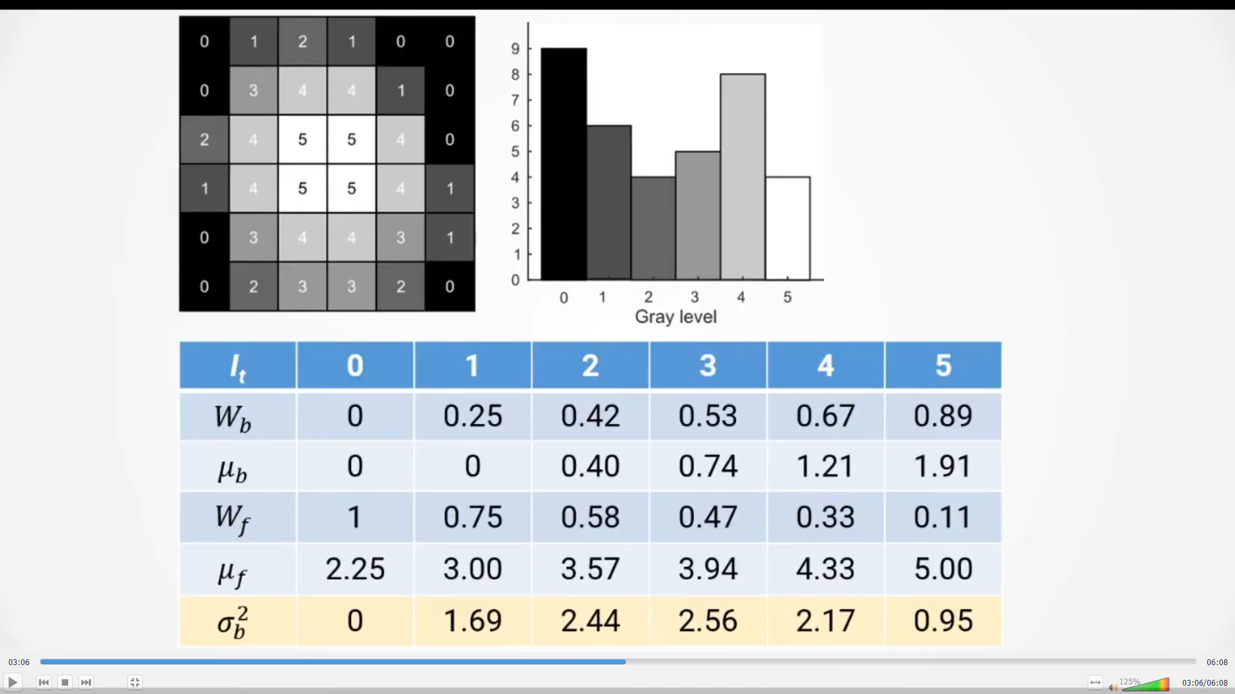

Slide 23
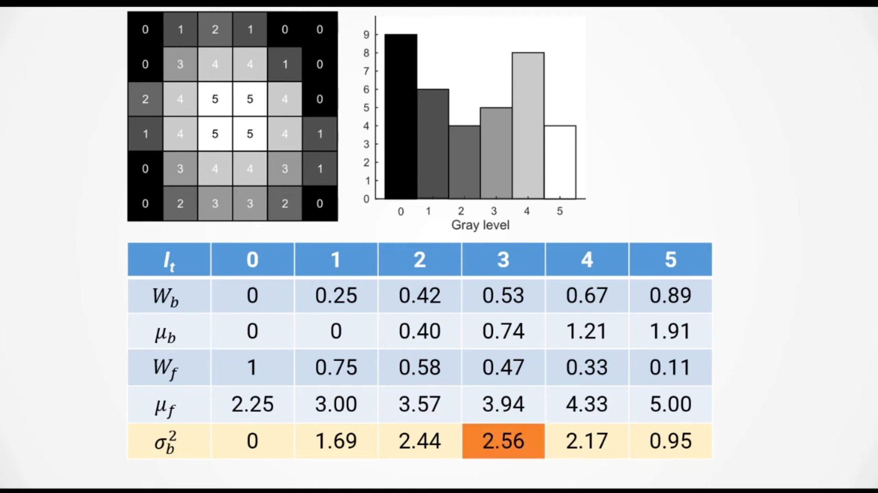

Slide 24
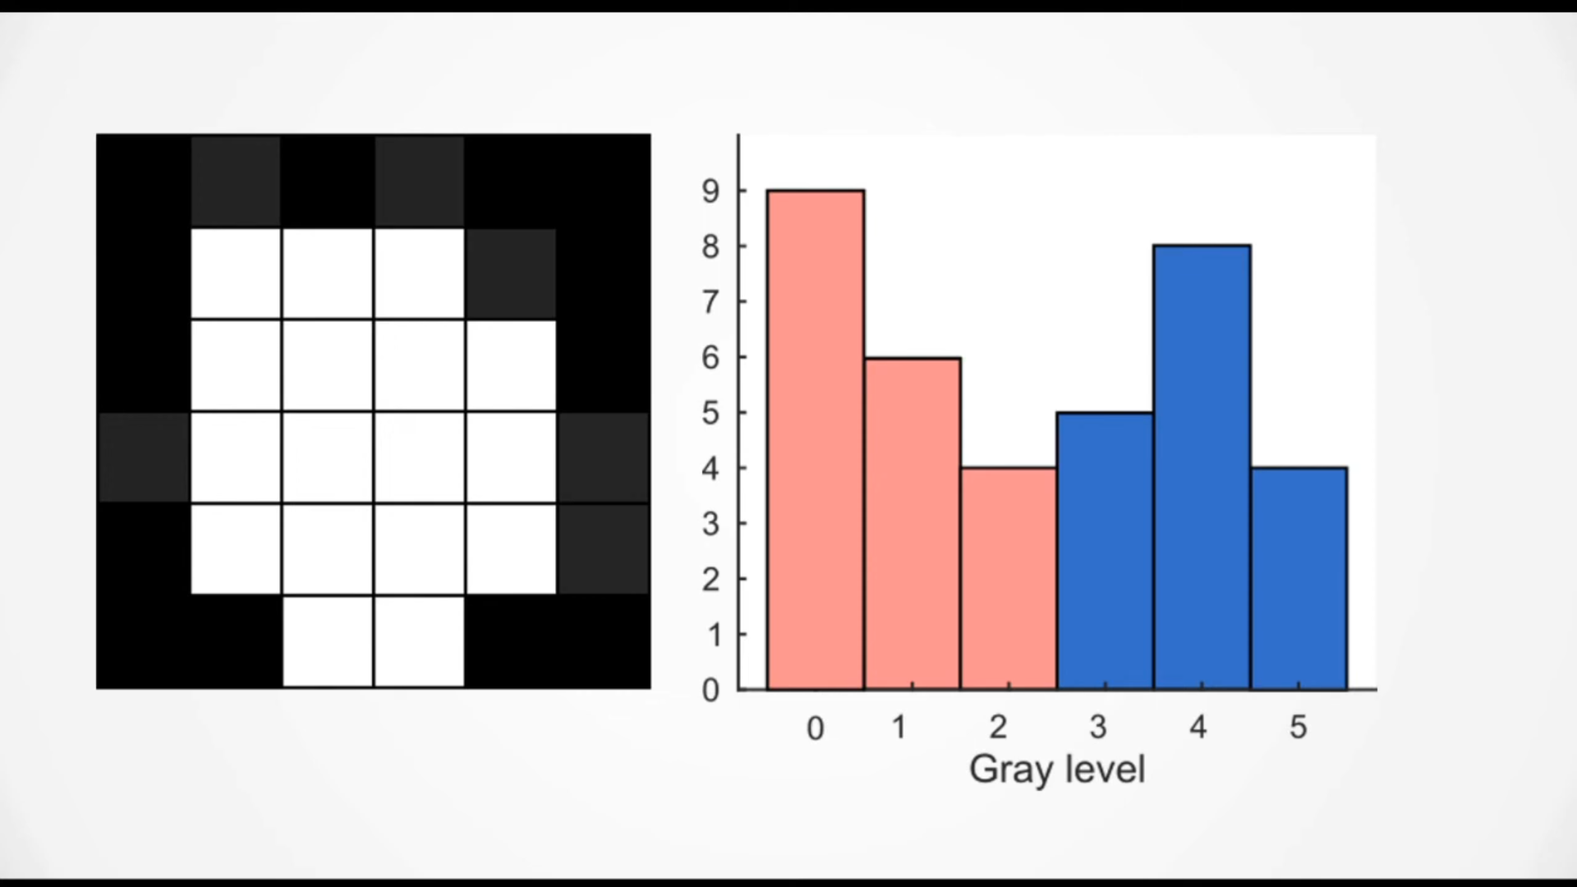

Slide 25
Otsu’s Method Implementation
from skimage import io, filters, color
image = io.imread(‘image_path.jpg’)
gray_image = color.rgb2gray(image)
# Compute Otsu's threshold
thresh = filters.threshold_otsu(gray_image)
# Apply the threshold
binary_image = gray_image > thresh
'binary_image' is the thresholded binary image.

Slide 26
Thresholding using Otsu Method: Complete Example
import numpy as np
import matplotlib.pyplot as plt
from PIL import Image
from skimage import filters, io, color
# 1. Read the image and convert it to grayscale
I = Image.open('coins.png').convert('L')
I = np.array(I)
# 2. Compute and Display the histogram
plt.figure(figsize=(10, 4))
plt.hist(I.ravel(), bins=256, range=(0, 255), fc='k', ec='k’)
plt.title('Histogram')
plt.show()
# 3. Compute the threshold level using Otsu's method
level = filters.threshold_otsu(I)
print(f'Level = {level / 255}')
# 4. Threshold the image to binary (black and white)
BW = I > level # This uses the threshold to convert the image to binary
# 5. Display the binary (B/W) image
plt.figure(figsize=(5, 5))
plt.imshow(BW, cmap='gray')
plt.title('Binary Image')
plt.show()

Slide 27
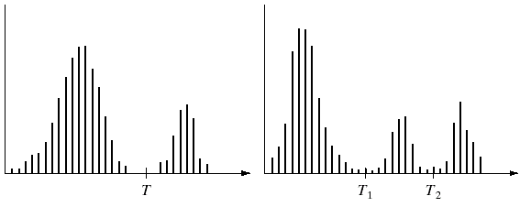
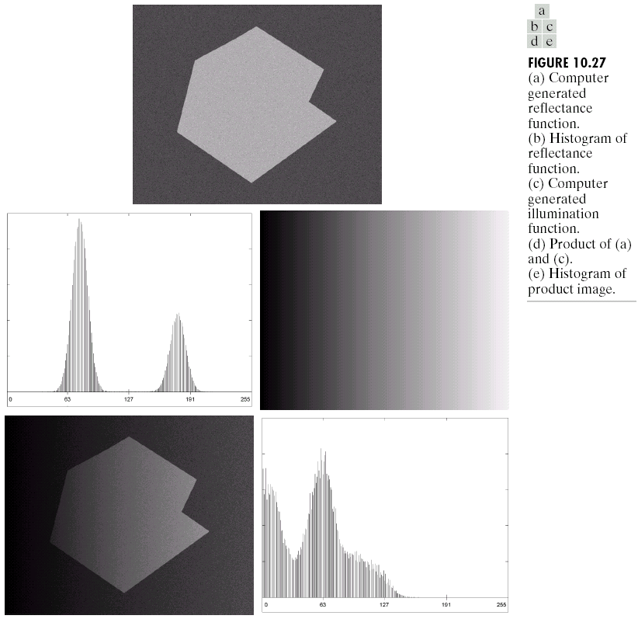
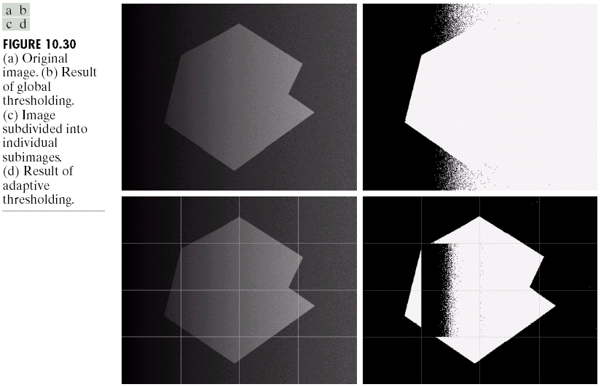
Problems With Single Value Thresholding
Single value thresholding only works for bimodal histograms.
Images with other kinds of histograms need more than a single threshold.
Uneven illumination can really upset a single valued thresholding scheme.
Images taken from Gonzalez & Woods, Digital Image Processing (2002)

Slide 28
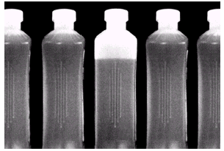
Problems With Single Value Thresholding (cont…)
Let’s say we want to isolate the contents of the bottles.
Think about what the histogram for this image would look like.
What would happen if we use a single threshold value?
Images taken from Gonzalez & Woods, Digital Image Processing (2002)

Slide 29
Segmentation of Water in Bottles
import numpy as np
from skimage.io import imread
from skimage.filters import threshold_multiotsu
from skimage.color import rgb2gray
from skimage.filters import median
from skimage.morphology import square
from PIL import Image
import matplotlib.pyplot as plt
# Read the image
b_gray = imread('bottles.tif')
# Apply multi-level Otsu thresholding
thresholds = threshold_multiotsu(b_gray, classes=3)
print(thresholds)
t =
[ 53 171]

Slide 30
Segmentation of Water in Bottles
# Generate binary images based on thresholds
bL = b_gray > thresholds[0]
bH = b_gray > thresholds[1]
# Create the liquid image by subtracting high threshold image from low threshold one
L = bL.astype(int) - bH.astype(int)
# Apply median filtering with a 9x9 square kernel
L1 = median(L, square(9))
t =
[ 53 171]

Slide 31
Segmentation of Water in Bottles
# Plotting
fig, axes = plt.subplots(2, 3, figsize=(15, 10))
axes = axes.ravel()
axes[0].imshow(b)
axes[0].set_title('Bottles')
axes[0].axis('off')
axes[1].imshow(bL, cmap='gray')
axes[1].set_title('Liquid White')
axes[1].axis('off')
axes[2].imshow(bH, cmap='gray')
axes[2].set_title('Liquid Black')
axes[2].axis('off')
axes[3].imshow(L, cmap='gray')
axes[3].set_title('Liquid with noise')
axes[3].axis('off')
axes[4].imshow(L1, cmap='gray')
axes[4].set_title('Pure Liquid')
axes[4].axis('off')
# Adjust subplot parameters to give specified padding
plt.tight_layout()
plt.show()

Slide 32
The Role of Uneven Illumination
Therefore, either balance the illumination or apply adaptive thresholding
Normal image
Intensity ramp in the range [0.2, 0.6]
Product of normal image and intensity ramp

Slide 33
Basic Adaptive Thresholding
An approach to handling situations in which single value thresholding will not work is to divide an image into sub images and threshold these individually
Since the threshold for each pixel depends on its location within an image this technique is called adaptive

Slide 34
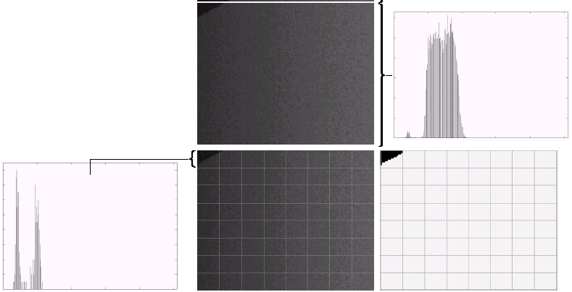
Basic Adaptive Thresholding Example
The image shows an example of using adaptive thresholding with the image shown previously
As can be seen, success is mixed
But, we can further subdivide the troublesome sub images for more success
Further subdivided the troublesome part, successful thresholding is achieved

Slide 35
The Role of Noise in Image Thresholding
Therefore the noise should be removed before thresholding.
Noiseless image
Image with additive Gaussian noise of mean 0 and standard deviation 10
Image with additive Gaussian noise of mean 0 and standard deviation 50

Slide 36
Assignment Task
Implement the Adaptive thresholding in Python. Your program should accept as input the following:
Image
Size of the grid for adaptive thresholding (A tuple with 2 elements, e.g., (10x10)
Optionally, remove noise from the image before applying thresholding.
Challenge: Also show the histogram of each sub-image, e.g., for a 10x10 grid, the plot will also follow a 10x10 layout, where each plot shows the corresponding histogram.

Slide 37
Conclusion
In this lecture we have begun looking at segmentation, and in particular thresholding.
We saw the basic global thresholding algorithm and its shortcomings.
We observed how noise or uneven illumination effect image segmentation.
We also saw a simple way to overcome some of these limitations using adaptive thresholding.
More complex segmentation tasks may require the use machine learning/deep learning based image segmentation models, e.g., pixel classification models, UNET etc.

